Slide 1
ONLINE RESERVATION SYSTEM

Slide 2
ABSTRACT
This project aims at creating an Online Hotel Management system which can be used by customers to reserve hotel rooms.
Users can check the rooms facilities and features.
The users can be able to send feedback as well.
The administrator will know the details of reservations .

Slide 3
EXISTING SYSTEM
In the existing system, the person who wants to book a room has to visit the hotel for booking hotel rooms, and enquiry.
The existing system is manual system.
The hotel management has to keep records of rooms manually.

Slide 4
DISADVANTAGES OF EXISTING SYSTEM
It is a time consuming process.
There is no surety of availability of rooms.
Paper work results in need of lot of space to keep the data.
Chances of human errors.

Slide 5
PROPOSED SYSTEM
To overcome the problems of manual system, online hotel management system is proposed.
The Central objective of Online Hotel Management is to provide online facility for booking rooms.

Slide 6
ADVANTAGES OF PROPOSED SYSTEM
Saves time of customers in quickly reserving rooms.
The ability to book rooms anytime, from anywhere with Internet access.
Provides the information about hotel facilities.
very secure.
User friendly.

Slide 7
USER Facilities
Check room availability.
Able to send feed back.
See facilities of hotel like restaurant.
Reserves room according to demand.
Rates features and services.

Slide 8
ADMINISTRATOR MODULE
Can login with unique user id and password.
Check details of rooms reserved for the current day.
Check details of rooms reserved for the coming days.
Can know the daily income.
Change prices of rooms.

Slide 9
HTA

Slide 10
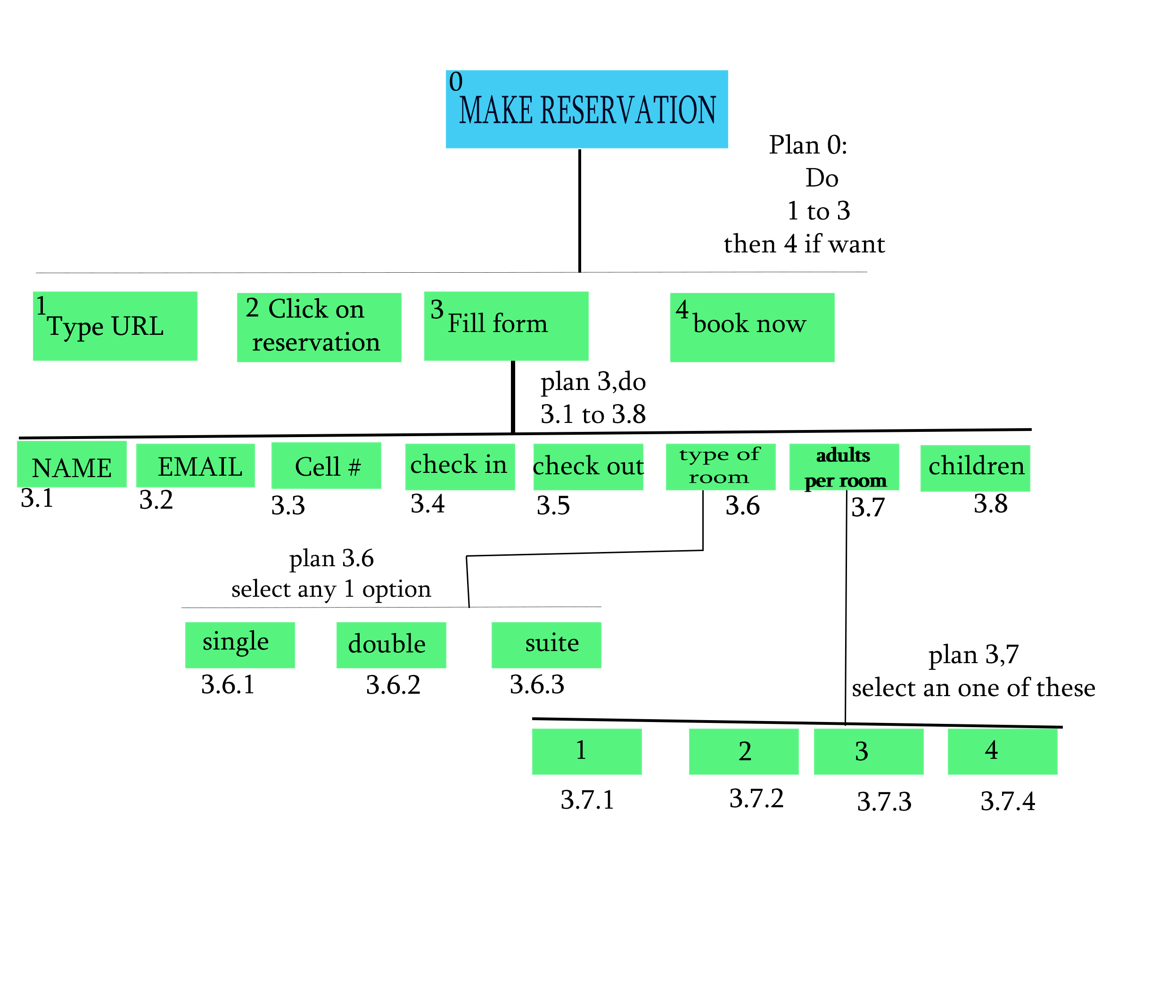
HTA

Slide 11
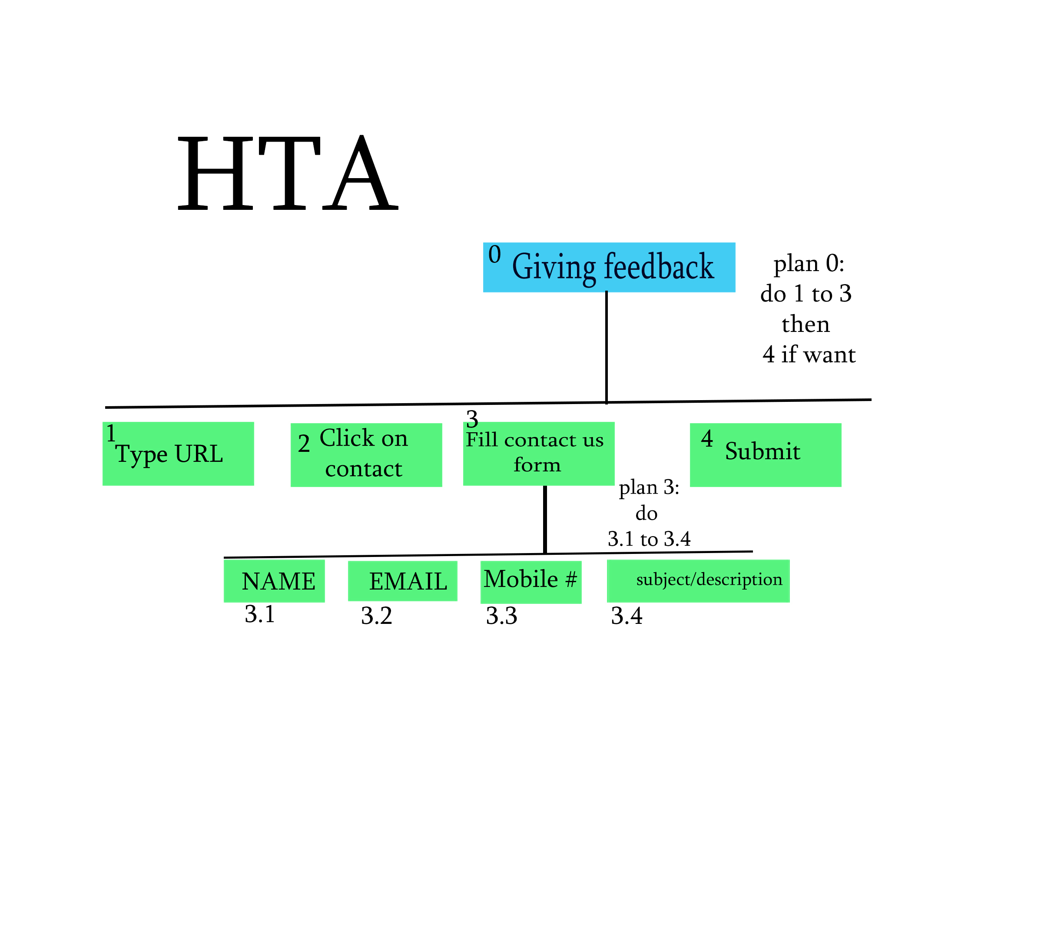

Slide 12
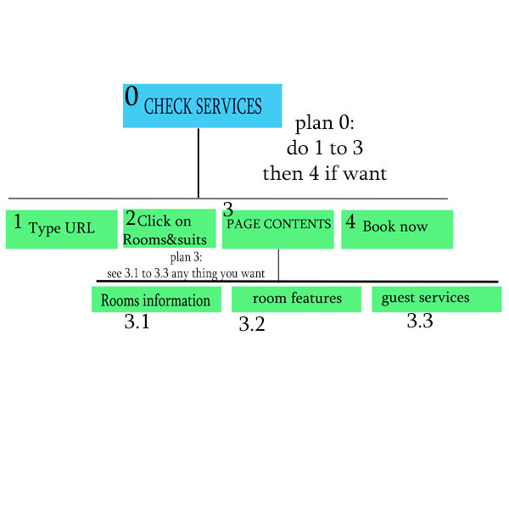
HTA

Slide 13
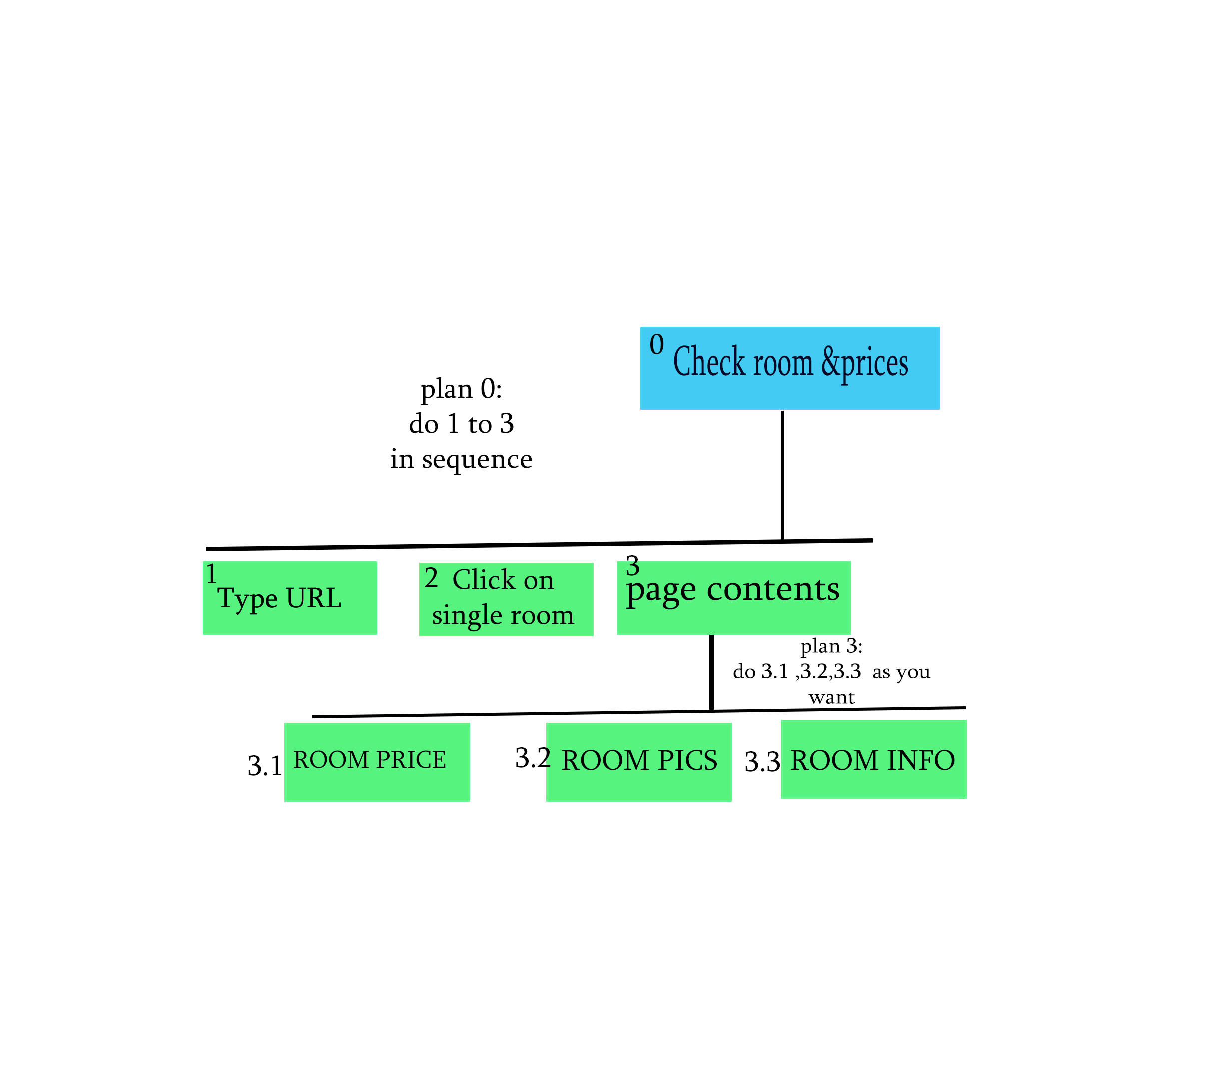
HTA

Slide 14
PROTOTYPES

Slide 15
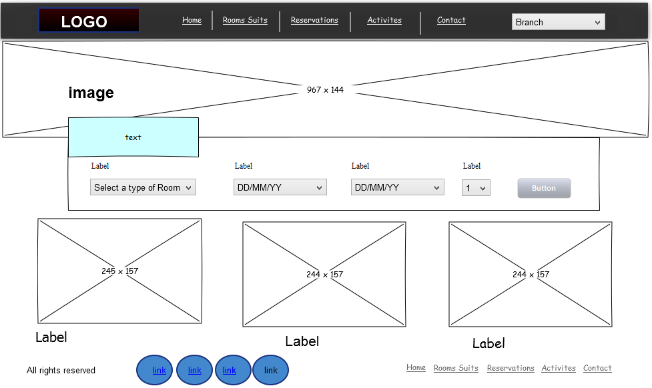
Main page

Slide 16
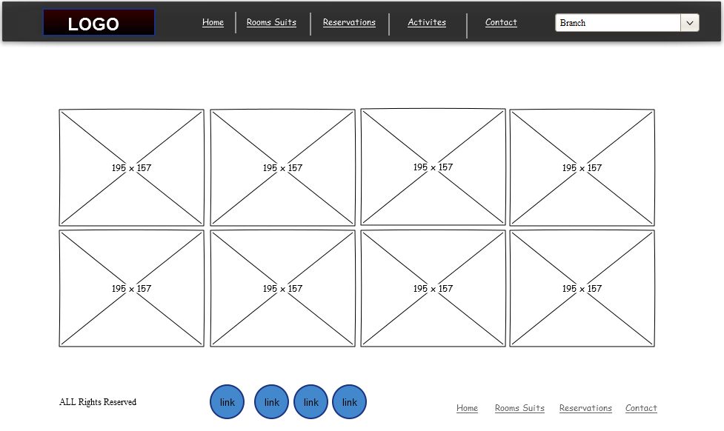
Activities page

Slide 17
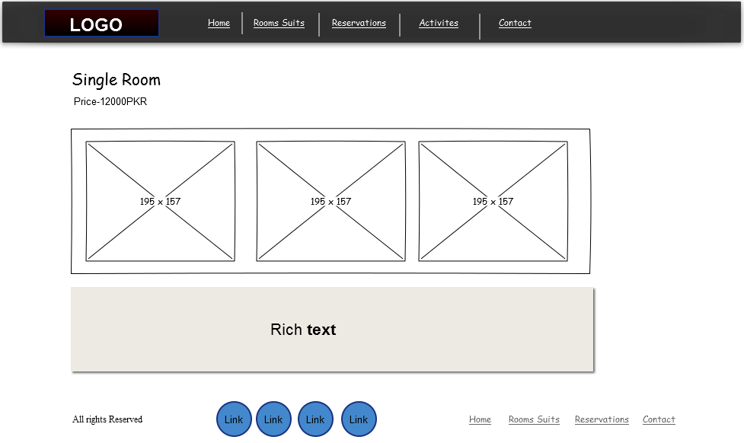
Single room page

Slide 18

Double
room
page

Slide 19
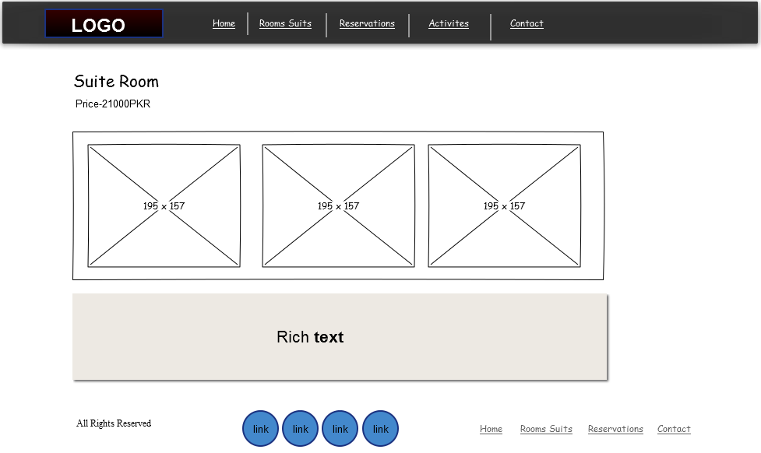
Suite
Room
Page

Slide 20
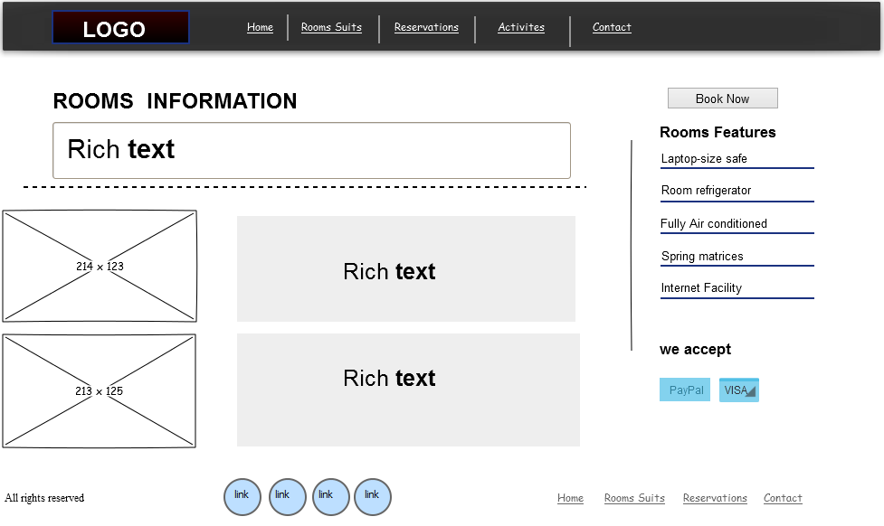
Rooms
&
Suites
Page

Slide 21
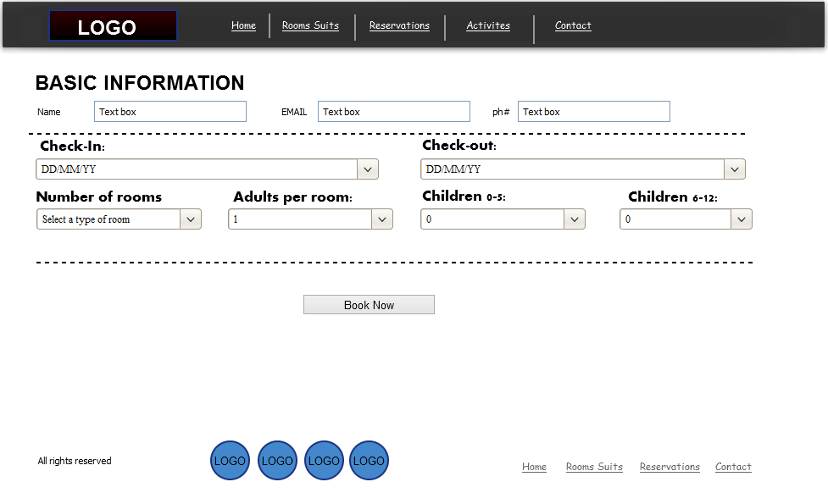
Reservation
page

Slide 22
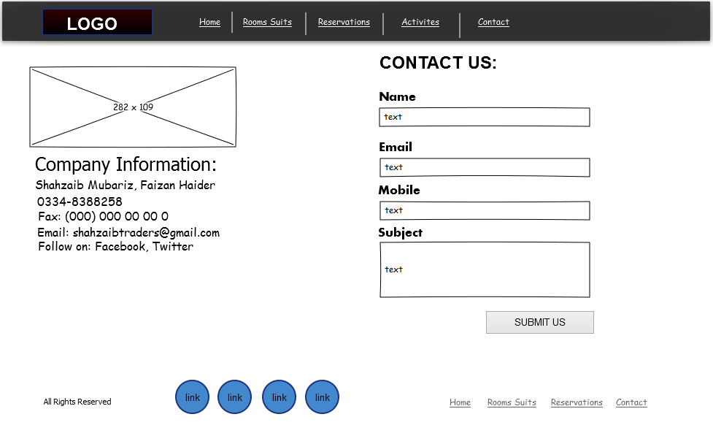
Contacts

Slide 23
THANK YOU

